Slide 1
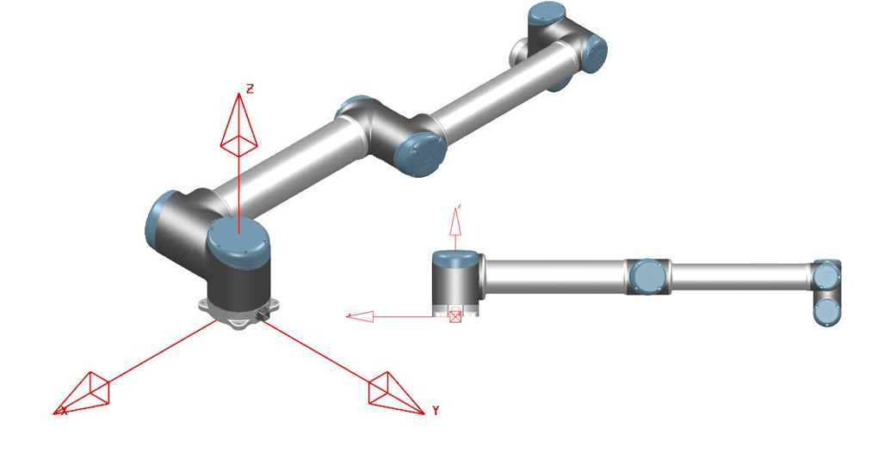
























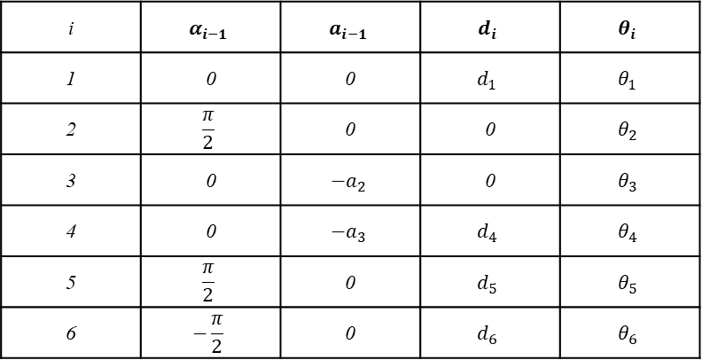

UR10 Kinematics – Craig’s Ver.
DH-parameter
$$d_{6}$$
$$d_{4}$$
$$z_{4}$$
$$d_{5}$$
$$x_{4}$$
$$z_{6}$$
$$x_{6}$$
$$x_{5}$$
$$z_{5}$$
$$a_{3}$$
$$z_{3}$$
$$x_{3}$$
Zero Configuration
$$z_{1}$$
$$a_{2}$$
$$z_{2}$$
$$z_{0}$$
$$x_{1,2}$$
$$d_{1}$$
$$x_{0}$$
i | $$α_{i−1}$$ | $$a_{i−1}$$ | $$d_{i}$$ | $$θ_{i}$$
1 | 0 | 0 | $$d_{1}$$ | $$θ_{1}$$
2 | $$\frac{π}{2}$$ | 0 | 0 | $$θ_{2}$$
3 | 0 | $$−a_{2}$$ | 0 | $$θ_{3}$$
4 | 0 | $$−a_{3}$$ | $$d_{4}$$ | $$θ_{4}$$
5 | $$\frac{π}{2}$$ | 0 | $$d_{5}$$ | $$θ_{5}$$
6 | $$−\frac{π}{2}$$ | 0 | $$d_{6}$$ | $$θ_{6}$$
Link0($d_{1}$) : 0.1273 m
Link3($d_{4}$) : 0.163941 m
Link1($a_{2}$) : 0.612 m
Link4($d_{5}$) : 0.1157 m
Link2($a_{3}$) : 0.5723 m
Link5($d_{6}$) : 0.0922 m

